Slide 1
Signals and Communication Systems (24EC2105)
Analog Communications

Slide 2
AM Generation (AM Modulators)

Slide 3
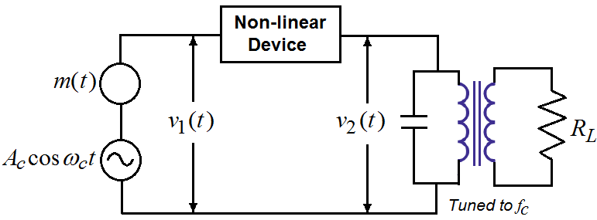
1. Square-Law Modulator
The diode-resistor equation is given by
Where and are constants.

Slide 4
Square-Law Modulator …
.
The output of the non-linear device (diode)
where
The first term is the desired AM wave with amplitude sensitivity
Remaining unwanted three terms are removed by appropriate filtering.

Slide 5
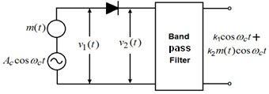
2. Switching Modulator
The input voltage to the diode ,
where .
Then

Slide 6
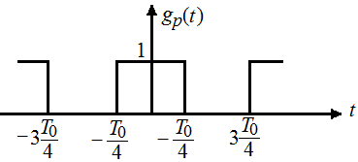
The desired components

Slide 7
AM Detectors / Demodulators

Slide 8
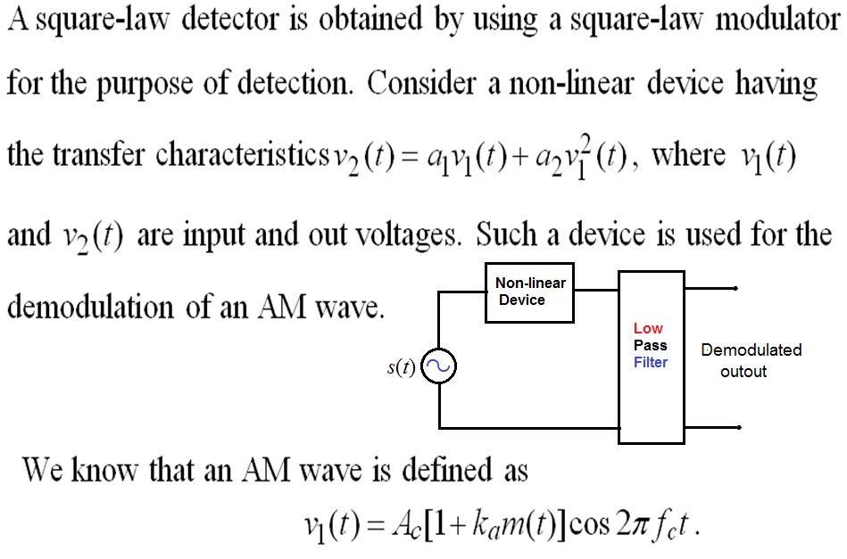
1. Square-Law Detector

Slide 9
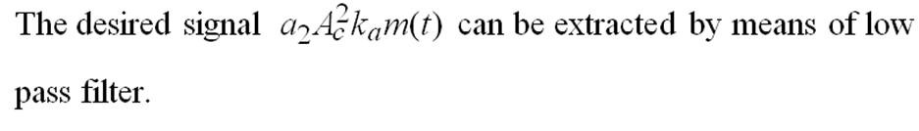

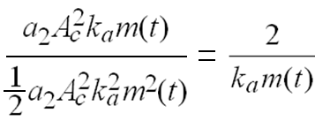

The term distort the message signal.
To avoid the distortion

Slide 10
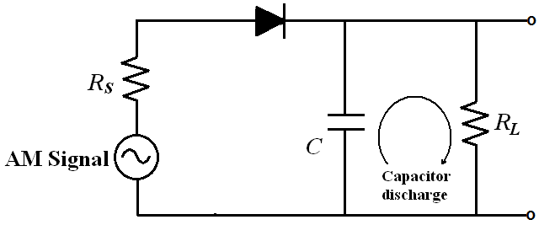
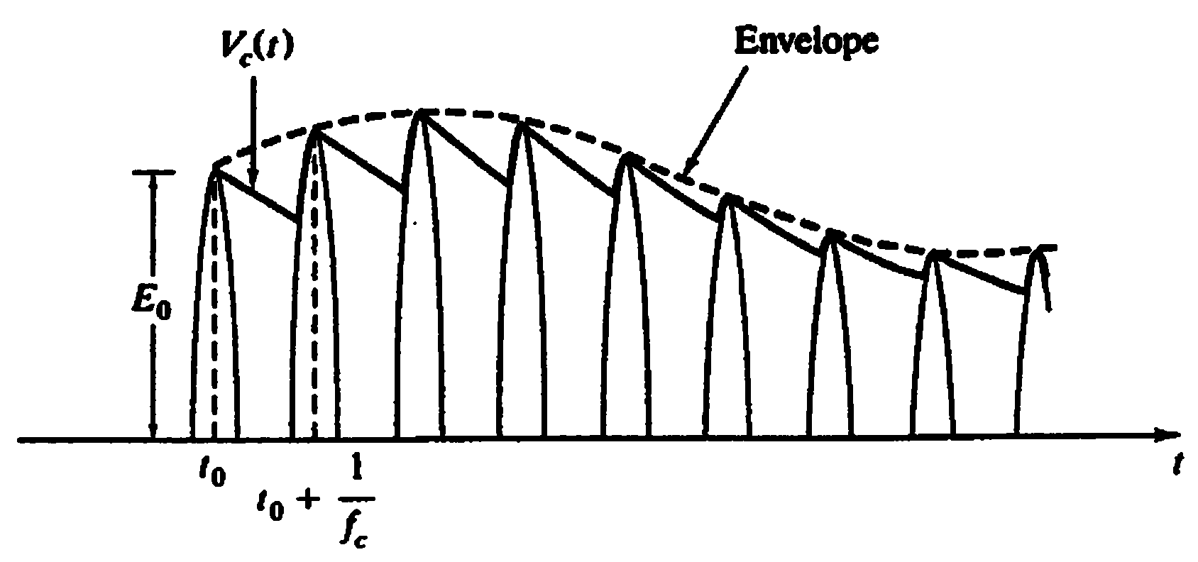
Envelope Detector
must be short.
C charges rapidly and follows applied voltage
be long enough to ensure that the capacitor discharges slowly through the load resistor

Slide 11
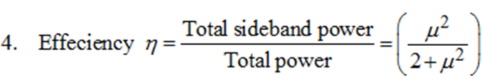
Main Points of AM
(a)
(b) For distortion less reception
2. The total power in AM is
3. The max power in AM wave is,
when .

Slide 12
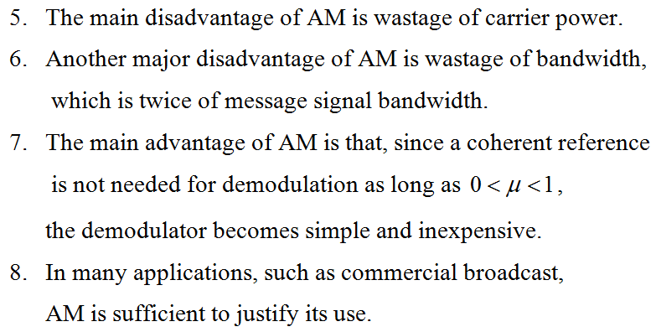
Main Points of AM

Slide 13
End

